Slide 1
A computational model of encoding / retrieval patterns in recognition memory
Dr. Evan Curtis
Sabbatical Presentation

Slide 3
The importance of models
Newell (1973) You can’t play 20 questions with nature and win
OSF (2015) Estimating the reproducibility of psychological science
Oberauer and Lewandowsky (2019) Addressing the theory crisis in psychology
Jamieson and Pexman (2020) Moving beyond 20 questions: We (still) need stronger psychological theory

Slide 4
Model-oriented experimental psychology
Core research process: 1) Establish precise empirical targets
2) Simulate behaviour in a theoretical model that is computational and formal
3) Evaluate correspondence between simulations and empirical data

Slide 5
The encoding / retrieval principle of memory

Slide 6
Producing an encoding / retrieval pattern

Slide 7
Producing an encoding / retrieval pattern

Slide 8
Producing an encoding / retrieval pattern

Slide 9
Producing an encoding / retrieval pattern

Slide 10
Producing an encoding / retrieval pattern

Slide 11
Producing an encoding / retrieval pattern

Slide 12
Producing an encoding / retrieval pattern
200 participants recruited from Mechanical Turk
100 each randomly assigned to the standard or rhyme recognition condition
Encoding condition manipulated within subjects

Slide 13
Producing an encoding / retrieval pattern

Slide 14
Key empirical targets
Matched encoding items
Interaction pattern – semantic advantage in standard recognition, phonological advantage in rhyme recognition
Non-matched encoding items
General semantic advantage Previous studies
Moderate semantic advantage in matched encoding items, even with interaction pattern (not found here)

Slide 15
The ATHENA model of memory
A THEory of Non-analytic Association (Curtis & Jamieson, 2019): A computational, formal simulation model of memory, based on Hintzman’s (1984, 1986, 1988) Minerva2 model, belonging to the broad class of instance theories
Conceptually expressed through two metaphors:
Memory is a geometric space
Retrieval is based on resonance within that space
Mathematically expressed through linear algebra

Slide 16
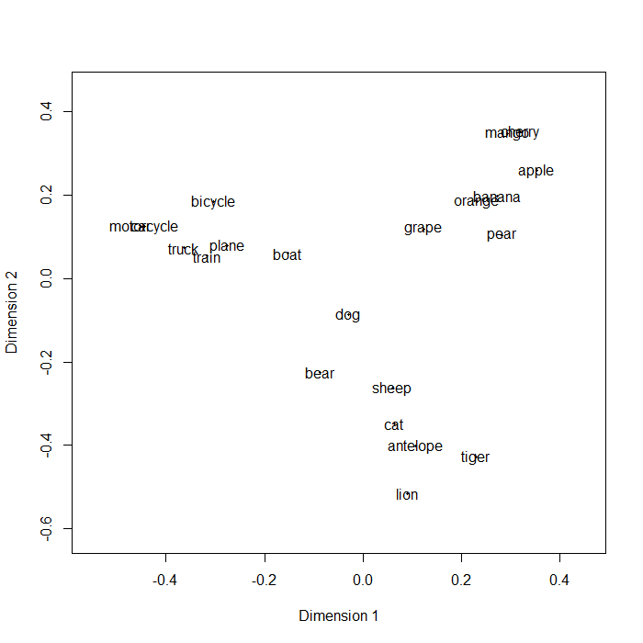
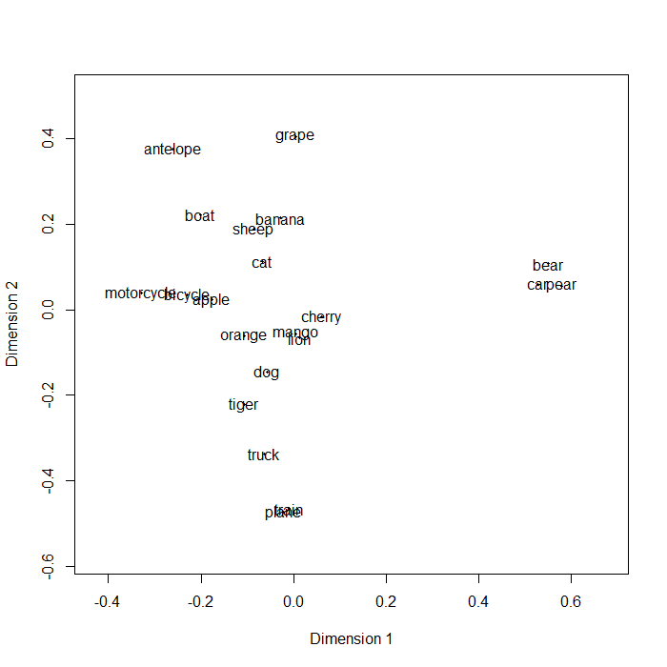
Encoding in ATHENA

Slide 17
Encoding in ATHENA – modifications
Adopted methods from advances in representations of semantics and phonology
Semantic information generated through Latent Semantic Analysis (LSA; Landauer & Dumais, 1997)
Phonological information generated using LSA methods applied to phoneme bigrams (Parrish, 2017)

Slide 18
Encoding in ATHENA – modifications
Altered the encoding process to allow for modification to the trace based on the model’s performance of the encoding task
The encoding prompt is integrated into the representation of the target word as a function of the similarity between prompt and target
$$s=\frac{\sum_{i=1}^{n}{x_{i}×y_{i}}}{\sqrt{\sum_{i=1}^{n}{x_{i}^{2}}}\sqrt{\sum_{i=1}^{n}{y_{i}^{2}}}}$$

Slide 19
Encoding in ATHENA - example
Semantic Phonological
FLAME 0.42 0.54 0.17 0.28 … -0.05 0.02 0.03 -0.04
HOT 2.33 0.13 1.05 1.97 … 0.02 0.04 -0.03 -0.03
Similarity (semantic) = .35

Slide 20
Encoding in ATHENA - example
Semantic Phonological
FLAME 0.42 0.54 0.17 0.28 … -0.05 0.02 0.03 -0.04
HOT 0.82 0.05 0.37 0.69 … 0.01 0.01 -0.01 -0.01
Similarity (semantic) = .35

Slide 21
Encoding in ATHENA - example
Semantic Phonological
FLAME 0.42 0.54 0.17 0.28 … -0.05 0.02 0.03 -0.04
HOT 0.82 0.05 0.37 0.69 … 0.01 0.01 -0.01 -0.01
Similarity (semantic) = .35
Stored to
memory 1.22 0.59 0.54 0.97 … -0.04 0.03 0.02 -0.05

Slide 22
Encoding in ATHENA - example
Semantic Phonological
FLAME 0.42 0.54 0.17 0.28 … -0.05 0.02 0.03 -0.04
HOT -0.05 -0.00 -0.02 -0.04 … -0.00 -0.00 0.00 -0.00
Similarity (phonological) = -.02
Stored to
memory 0.37 0.54 0.15 0.24 … -0.05 0.02 0.03 -0.04

Slide 23
Retrieval in ATHENA

Slide 24
Retrieval in ATHENA
$$a={\left(\frac{\sum_{i=1}^{n}{x_{i}×y_{i}}}{\sqrt{\sum_{i=1}^{n}{x_{i}^{2}}}\sqrt{\sum_{i=1}^{n}{y_{i}^{2}}}}\right)}^{3}$$
$$c_{j}=\sum_{i=1}^{m}{a_{i}×M_{ij}}$$

Slide 25
Retrieval in ATHENA - modifications
Semantic and phonological features of test cues differentially weighted depending on recognition task
Semantic features more heavily weighted in standard recognition
Phonological features more heavily weighted in rhyme recognition
Ignored / unattended features set to zero

Slide 26
Model simulations
Generate vector representations of each target word and encoding prompt
Store target words, weighted by the encoding prompt based on vector similarity, to a memory matrix
Present each target word as a cue and retrieve an echo
If the echo is sufficiently similar to the cue, endorse the item as having been studied

Slide 27
Empirical results (for reference)

Slide 28
Simulation results

Slide 29
Insights
Explanations of encoding / retrieval interactions are generally along the lines of “performance is improved because processing at encoding was appropriate for retrieval”
This is vague at best, and arguably circular
Examining the problem in a computational model forces a clear articulation of cognitive processes

Slide 30
Insights
Information stored to memory is a product of cognitive processing required at encoding
That product is an aggregate of the target information itself and the contextual information used to process the target
The extent to which contextual information alters target information is a function of the similarity-driven operations of the cognitive system

Slide 31
Insights
Retrieval tasks differ in the nature of the cues presented to memory and the information that needs to be reconstructed
Memory performance is determined (in part) by the utility of the information stored to memory
Utility is defined as the extent to which the stored information effectively bridges the gap between the cue and the information to be reconstructed (again, driven by similarity)

Slide 32
Next steps
Manuscript in preparation for submission to the Journal of Experimental Psychology: Learning, Memory, and Cognition
Submitting for presentation to the Canadian Society for Brain, Behaviour, and Cognitive Sciences
Extension to other types of retrieval tasks (e.g., cued recall)

Slide 33
Next steps
Deriving and testing novel predictions from the model (e.g., effects of encoding on false memory)
Interactions with memory impairment (e.g., aging, Alzheimer’s disease, anterograde amnesia)
Movement out of the laboratory and into classroom settings (e.g., how should a student study for MC vs. essay exams?)

Slide 34
Acknowledgements / Collaborators
Nick Brosowsky
Dominic Guitard
Randy Jamieson
Aryn Pyke
Nick Reid
Jean Saint-Aubin
Jackie Spear

